Slide 1
Prastut Corporate
Credential
INNOVATIVE CATALYTIC SOLUTIONS
Research, Data, Business Advisory
2020

Slide 2
About PRASTUT
Prastut is a market research based strategic management company based out of Sohna Road Gurugram, Haryana, India
Prastut established in 1998 is among the the industry leaders, with a vastly diverse domain experience
Prastut is founded by SANGEETA AGRAWAL, PGP, IIM Ahmedabad, she is a fifth generation entrepreneur, and a professional par excellence
Prastut empowers its clients with the intelligence that they need quickly, clearly in actionable form and at highly competitive cost.
The Prastut team has a collective experience and market research intellectual capital of 200+ years.

Slide 3
PRASTUT POWER
Prastut understands the difference between serious research and superficial surveys. We don’t believe in just
skimming the surface. Our team of researchers conduct an in-depth analysis required for mining insights.
Industry Leadership
Extensive knowledge and insights of the market
20+ years in the market
Agile Project Execution
Expert Advice
Use of cutting edge technology for new, transparent and user friendly methods of data collection
Customised research model for every individual project
Use of knowledge acquired across projects to draw deep insights about Consumer Behaviour
Worked with more than 100 clients across multiple sectors
1000+ Actionable Reports used by clients globally

Slide 4
Prastut aims to understand the problems and helps to find the right solution and at the same time focuses on activities that add value.
The Prastut Advantage
Ask questions and get answers specific to your needs; Build confidence about your product
Prastut gives you fast, real-time feedback and solutions to your problems for quicker results
Get access to a wide number of qualified consumers relevant to your business across the country.
Experience and expertise of 20+ years, Innovative research methods: Get the best of both Mentorship and Guidance at every step of your journey, at affordable and flexible rates.
Notes:
Photo by Sean Pollock on Unsplash

Slide 5
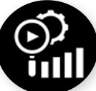
Service Spectrum
We at Prastut provide you Market Research, Advanced Analytics, Market Intelligence Services and Consulting. We are here to assist you create decisions at the speed of business.
We specialize in TECHNOLOGY DRIVEN HUMAN VALIDATED SOLUTIONS. This is a mixture of efficient research technologies with human intelligence to deliver the knowledge that's relevant for your organization and business objectives. Our analysts offer highlighted summary translated or validated for our clients.
PRIMARY MARKET RESEARCH
ADVANCED ANALYTICS
MARKET INTELLIGENCE
BUSINESS ADVISORY
Qualitative Research
Quantitative Research
Online Survey
Mobile Survey
Competitor Bench Marking
Data Analysis
Traditional analysis
Social Media Analysis
Big data analysis
Primary competitor surveys
Industry monitoring & profiling
Market Opportunity Assessment
Customer Profiling
For Companies
Lean market research
for startups
For companies
investing in startups
Notes:
Photo by Sean Pollock on Unsplash

Slide 6
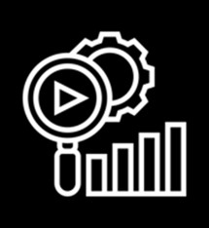
Prastut Service Benefits
We provide a consolidation of the best amount of data in a short amount of time.
We assist to understand the impact with more informed decisions.
Apart from that human validated content means getting simply relevant information.
CONSOLIDATION
RESPOND FASTER
KNOWLEDGE

Slide 7
Primary Market Research
QUANTITATIVE RESEARCH
QUALITATIVE RESEARCH
ONLINE & MOBILE SURVEY
Brand Studies – Track, Perception, Health Monitor, Matrix, Pathway, Performance, and Strategy
Brand Equity Index
CSAT Trend Analysis
Communication Testing using EPIC Model (Empathy, Persuasion, Intent and Comprehension)
Price Tracking, Obtaining the right price point using different pricing scales
Product Development, Concept Development and testing
Loyalty Track using Net promoter surveys
Shopper Insights, profiling using retail intercepts
Branding and Nomenclature Research
Product features trade off Using conjoint analysis
Consumer U & A, Buyer Behaviour.
In Depth Interviews
Industry Scan
Focus group discussions
Diads/ Triads
Ethnographic Studies
Market Visits
Market/Channel Scan
Brand Stakeholder workshops
Internet based research survey design by keeping in mind the target audience & scope of study through Email, SMS, WhatsApp mode.
Online Qualitative facility
COMPETITOR BENCH MARKING
DATA QUALITY & ANALYSIS
Competitor survey design to access what are the offerings and attractive facilities competitor brands are providing.
Qualitative data ,quantitative data or a mixture of both, is brought together and analyzed using statistical tools in order to draw conclusions.
Conclusions are then used to generate key insights and building the report
Notes:
Photo by Sean Pollock on Unsplash

Slide 8
Advanced Analytics
TRADITIONAL ANALYTICS
SOCIAL MEDIA ANALYTICS
BIG DATA ANALYTICS
Factor Analysis
Cluster Analysis
Time Series Analysis
Linear Regression Analysis
Correspondence Analysis
Key Driver Analysis
Conjoint Analysis
Discriminant Analysis
Social Media Listening
Mining Consumer Conversations
Deriving Brand Association Maps
Voice of Customer Analysis
Data Visualization
Predictive Analytics
Customer Analytics
Channel Analytics
Notes:
Photo by Sean Pollock on Unsplash

Slide 9
Market Intelligence
MARKET INTELLIGENCE TOOLS
MARKET INTELLIGENCE REPORTS
Market Opportunity Assessment
Size, growth, key segments, attractive segments, market potential, critical success factors
Competitor Assessment
Finding main industry participants, market share, value proposition, SWOT, Evaluating strategies to build an advantage
Brand Positioning Assessment
Gap Analysis, Perceptual Mapping, Brand Health Measurement (Behavior, Perception, Image and Performance), Brand Asset and Equity measurement, Customer Touch Point Experience
Business and Secondary research Syndicated Published Sources: Government and Industrial bodies
Primary Market Research-Qualitative and Quantitative Surveys
Identifying and profiling target segments for sharper focus using attitudinal data layered on the basic demographic data through multivariate cluster analysis and other tools
Market and Competitor Surveys
Mystery audits for channel assessment, store assessment v/s standard operating procedures, competitor information through use of intelligent networks at the ground level.
Notes:
Photo by Sean Pollock on Unsplash

Slide 10
Business Advisory
FOR COMPANIES
LEAN MARKET RESEARCH FOR START-UPS
FOR PE FUNDS AND INVESTORS IN START-UPS
Competitor benchmarking using SWOT analysis
Perceptual Maps and Market Intelligence Data
Market Demand Estimation
Market Strategy Inputs using Ansoff growth matrix, Technology Adoption Curve, Value Proposition, Identifying Critical Success Factors
Evaluating Go-To-Market strategies used for their efficiency and effectiveness by designing customized research tools and measures
Supply Chain research – Concept testing distribution models
Employee Satisfaction- Research design, data processing, analysis and reports
Front line sales person – satisfaction, motivation, rewards and recognition
Co Creation Research
Quick Testing of New Ideas
Platform for beta testing of mobile app/website
Revenue Model/Ticket Size which would work
“Go-No Go” Decision
Evaluate current business status and scale up potential of start-ups funded by investor/PE funds through primary research
Notes:
Photo by Sean Pollock on Unsplash

Slide 11
Prastut “Plus”
We provide a consolidation of the best amount of data in a short amount of time.
We assist to understand the impact with more informed decisions.
Apart from that human validated content means getting simply relevant information.
CONSOLIDATION
RESPOND FASTER
KNOWLEDGE

Slide 12
TRUSTED BY GLOBAL BRANDS

Slide 13
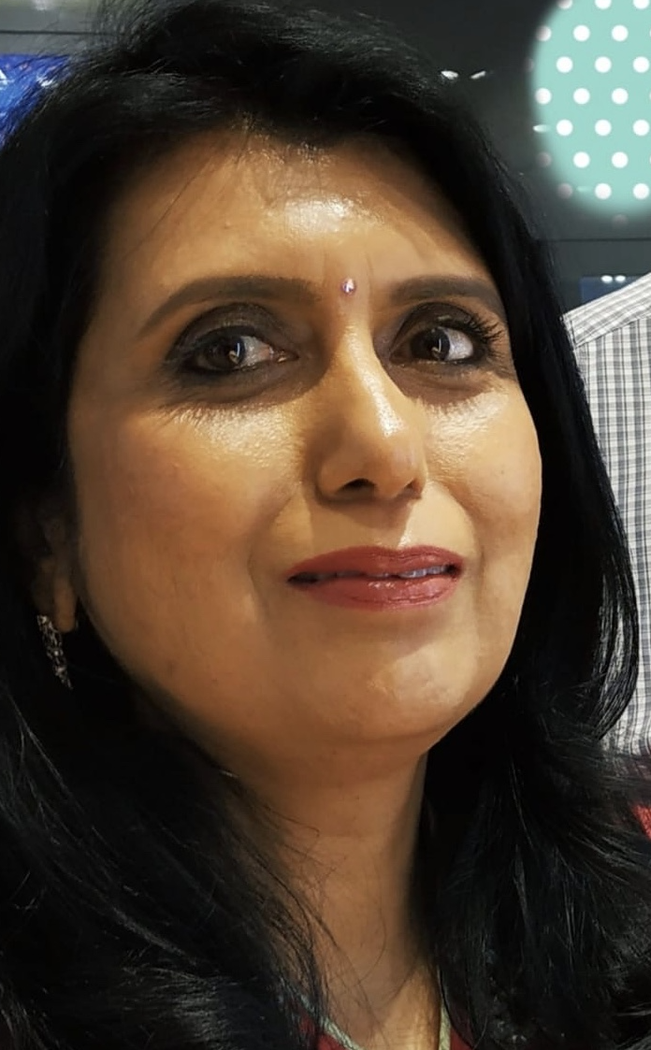
PRASTUT LEADERSHIP
Sangeeta Agrawal
Founder - Director
The company was founded in 1998 and is headed by Sangeeta Agrawal: (Founder Director) IIM-Ahmedabad.
Sangeeta is a business focused professional, having extensive experience in market research, consulting and academia. Her professional career spans across 30-plus years of experience in market and consumer research, business intelligence, market entry strategy and business performance turnaround.
She uses her critical thinking, data crunching and advance research capabilities to correlate key data and insights from the consumer and market trends with the larger picture for the industry/business to derive new segments and opportunities for business growth. Her strengths include breaking down complex problems into simple, measurable solutions, building things from scratch and growing them into profitability, ethical leadership, strategic vision and a razor sharp focus on the constantly shifting market research industry.
As a business leader she is at the forefront to use the latest state-of-the-art technology tools for more efficient working of the business. This has involved visioning, planning, building and mentoring teams and thought leadership.
Her mantra for success: The Devil Lies in the Details.
Sangeeta is a published author with two books - “Real Time Strategic Management” in April 1996 by Global Business Press and “Marketing Research-Concept and Cases” in November 1994 by Global Business Press and also numerous white papers.

Slide 14
PRASTUT LEADERSHIP
Pradeep Agrawal
Director – Data, Technology and Finance
Pradeep brings with him decades of experience with Technology and Data. Pradeep is a production person at heart – A Mechanical Engineer from NIT, Rourkela followed by a Post Graduate from IIT –Delhi. Pradeep has a deep sense of business acumen which has been honed at the family business during his 25 year tenure as a Director at Coirfoam India Pvt. Ltd.
At Prastut since last 10 years, Pradeep has been at the forefront of Technology innovations. He has spearheaded the Automation of Data into Power Point Reports, Online Survey Programming, Predictive Dialling for Telephonic Research, Mobile App Development for Retail Audits, Time and Motion Studies etc.
Pradeep is passionate about Data Mining and Analysis and has successfuly worked on files comprising of data in millions. Data from the large sample surveys conducted by Prastut has been analysed, sliced and diced into an array of multiple rows and columns through astute syntax file planning and preparation. Our fast project turnarounds are easily managed due to readiness of the data analysis team to work on the data through prior programming.
Pradeep had brought to fore his creativity with data through adopting lateral methods to obtain new data points for correlation.

Slide 15
Prastut Core Team
Binay Singh,
Chief Research Officer
Binay has led and delivered a very challenging nation wide primary research covering more than one lakh households to the utmost satisfaction of the client.
Binay is connected with the Operations teams, Data teams and Top Management to cohesively integrate and deliver projects to the client’s delight.
Vijendra Prasad
Manager Operations
His expertise lies in building a network of resources for audit research and panel purposes,. Vijendra is also a skilled qualitative moderator for trade/channel studies. Vijendra is adept with technology, he is constantly using new platforms to reach out to respondents to get their maximum engagement in audit and social projects.
Tripati Sharma
Research Consultant
She conducts specialised and targeted research on behalf of the client and produces a final analysis of key findings. She has 12 years of experience in Market research across all the processes. A good understanding of statistics and data collection processes has equipped her to understand the market and consumer behaviour patterns deeply.
Jai Prakash Yadav
Manager Data Operations
Jaiprakash manages the Prastut team of analysts, researchers and field investigators and support staff.
He is the vital link between the Operations Teams and the On-Ground teams in terms of making travel and logistics arrangements and providing tools like cameras, recorders, laptops for conducting of the projects seamlessly.
Aparajita Rastogi
Senior Project Manager
Aparajita is a generalist, she is able to lead all phases of any project. She is an astute project manager, leads Customer Satisfaction and NPS studies at Prastut, manages the In-House research team, external vendors for App development and other technology requirements. She has good experience across multi-method studies.
Barababu Singh
National Field Manager
Barababu Singh,has given his 30+ years’ experience in handling all ground level field work in the remotest villages across all States in India.
He brings the research alive with his avid interactions and keen observations across research locations. He has a knack for dealing with multiple project teams with ease and coming up with the best from them.
Team Prastut is extremely ambitious to drive informed decisions across global enterprises. From experienced researchers to talented developers, we have a range of disciplines to fulfil our vision into reality. Our Field teams, Senior Leadership, Research Experts, Technology Development and Business Support aim at working together to provide the best experience to our clients.

Slide 16
Contact Us
Prastut Consulting Pvt Ltd. B2/1056, Spaze I Tech Park
Sohna Road, Gurgaon - 122 018 Phone: 0124 483 7220 – 43
Notes:
Photo by Sean Pollock on Unsplash

